Slide 1
Management and Leadership

Slide 2
Learning Goals
Describe the roles of management: planning, organising, controlling, and directing.
Describe the characteristics of a good leader.
Define and outline the main features of different leadership styles: autocratic, paternalistic, demographic, and 'laissez-faire'.

Slide 3
Question
What is a leader?
What makes a good leader?
What does this mean?
“Not all leaders are managers,
nor are all managers leaders”

Slide 4

Is there a difference between leaders and managers?
VS
Leaders
Managers
Inspire
Take risks
Set strategy
Are followed
Implement others ideas
Use authority
Manage risks
Have subordinates

Slide 5
Managers Versus Leaders
“Not all leaders are managers,
nor are all managers leaders”
Managers
Persons whose influence on others is limited to the appointed managerial authority of their positions
Leaders
Persons with managerial and personal power who can influence others to perform actions beyond those that could be dictated by those persons’ formal (position) authority alone

Slide 6
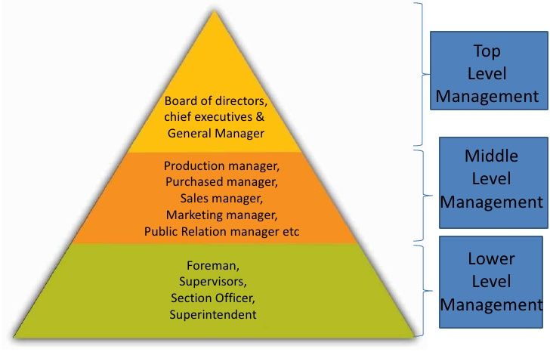
Levels of Management

Slide 7
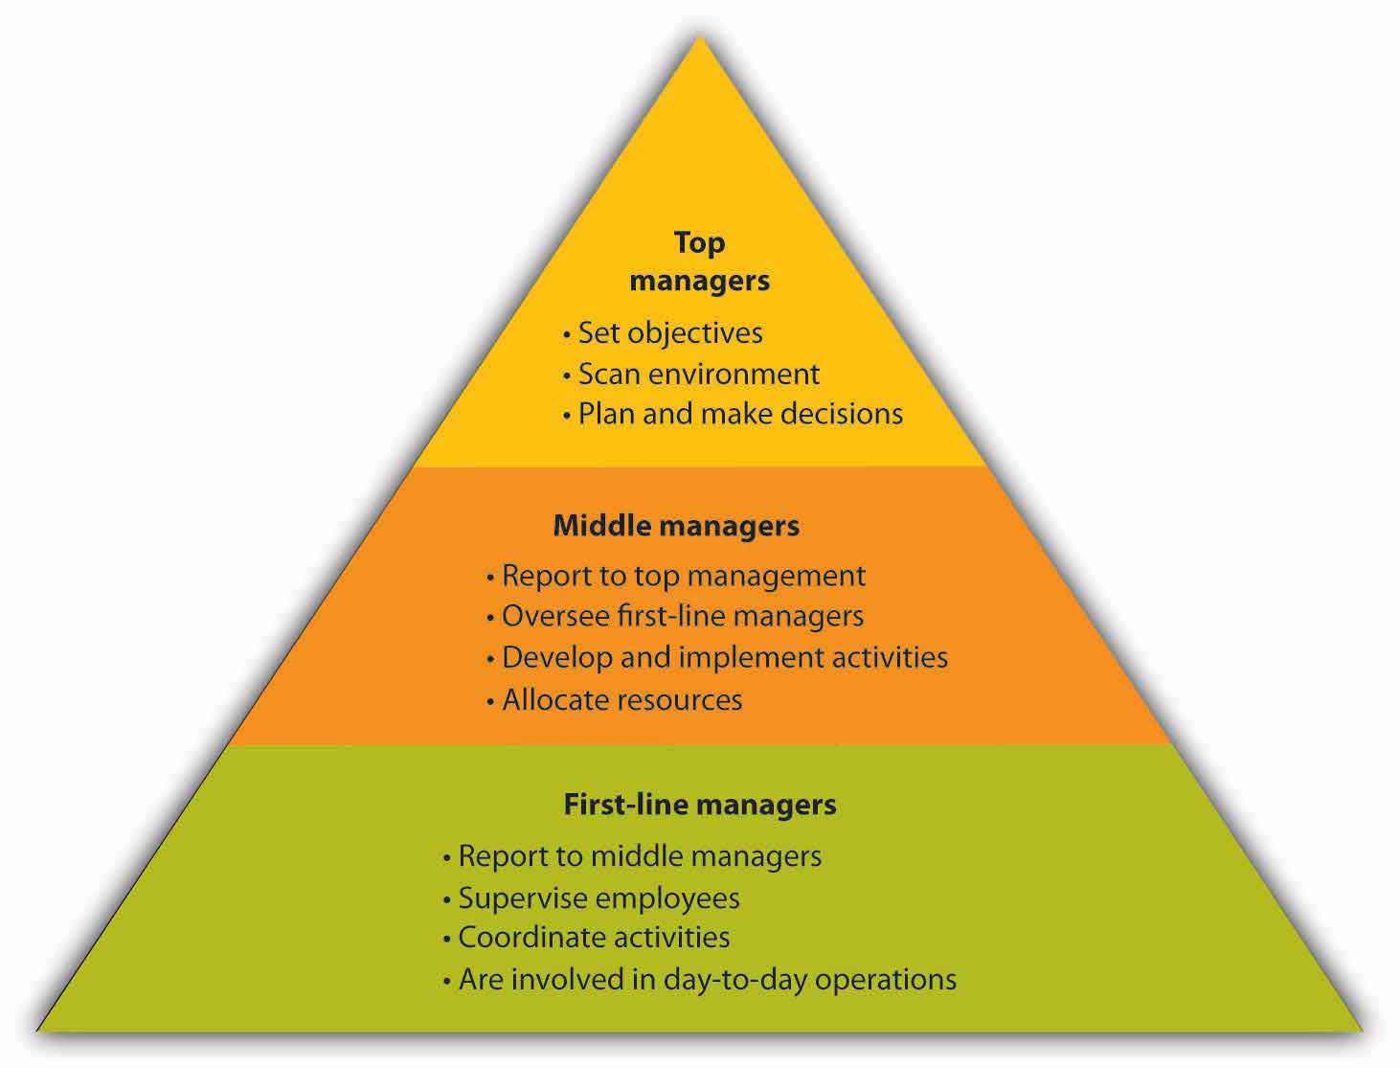
Levels of Management

Slide 8
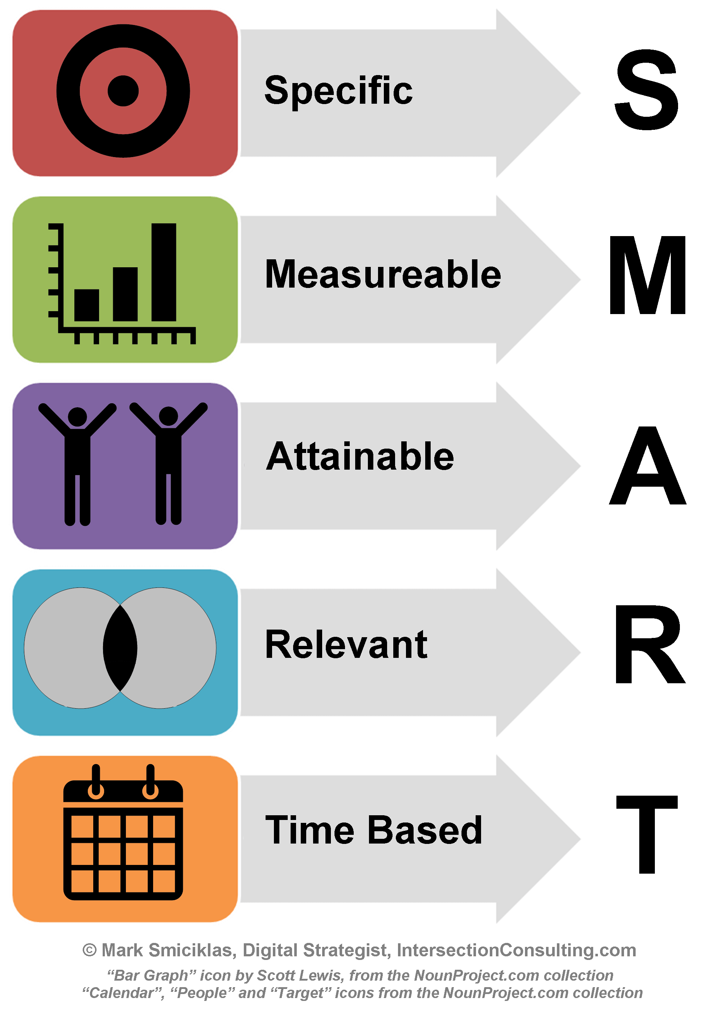
Role of Managers - Objectives Setting
• Planning involves setting objectives and also the strategies, policies, programmes and procedures for achieving them.
• This will be done by line managers who are responsible for performance.

Slide 9
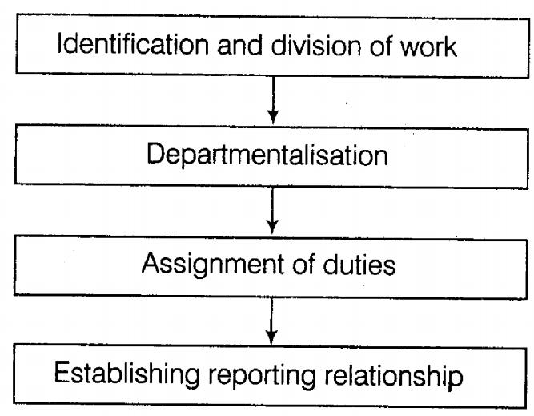
Role of Managers - Organising
• Managers will set tasks which need to be performed if the business is to achieve its objectives.
• Jobs need to be organised into sections / departments and authority delegated for jobs to be carried out.

Slide 10

Role of Managers - Communicating
• It may include newsletters, systems of meetings, consultation with employee representatives.
• It will be designed to inform employees and achieve a desired level of consultation with staff.

Slide 11
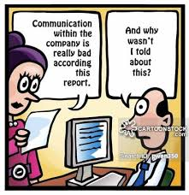
Role of Managers - Communicating
Without effective communication, employees do not know what to do, why they should do it, when to do it or how.
Effective communication is vital for successful decision making, to make good decisions a manager needs high quality information.

Slide 12
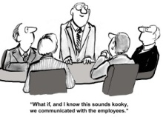
Role of Managers - Communicating
Good communication is also important to employees. They need to know how they are doing, what they are doing right and how they can improve.
Well-managed employer /employee communications can have a great effect.

Slide 13
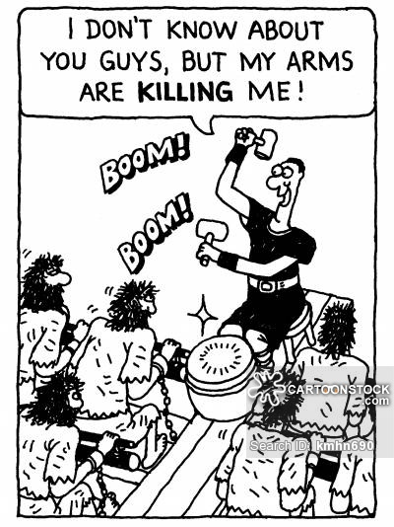
Role of Managers – Coordinating
Brings together all activities of people within the business. Individuals / groups may have their own goals which are different to the business, a manager ensures that everyone is working towards the business goals.

Slide 14
ACTIVITY - Leaders
Write down the five most powerful and influential living people you know about who are described as leaders. (Try and make them business people.)
Write down the special qualities you think these people have that make them leaders.

Slide 15
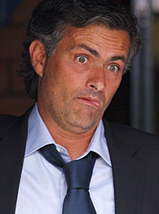

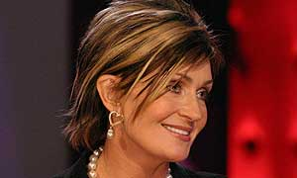
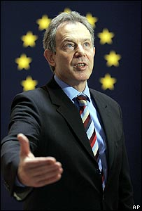
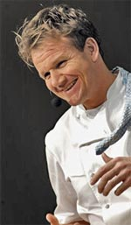
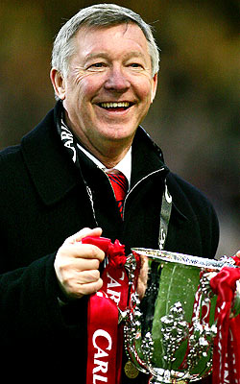
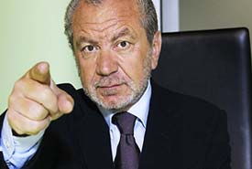
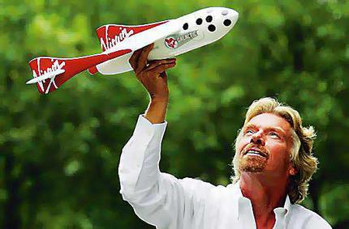
Possible Answers…

Slide 16
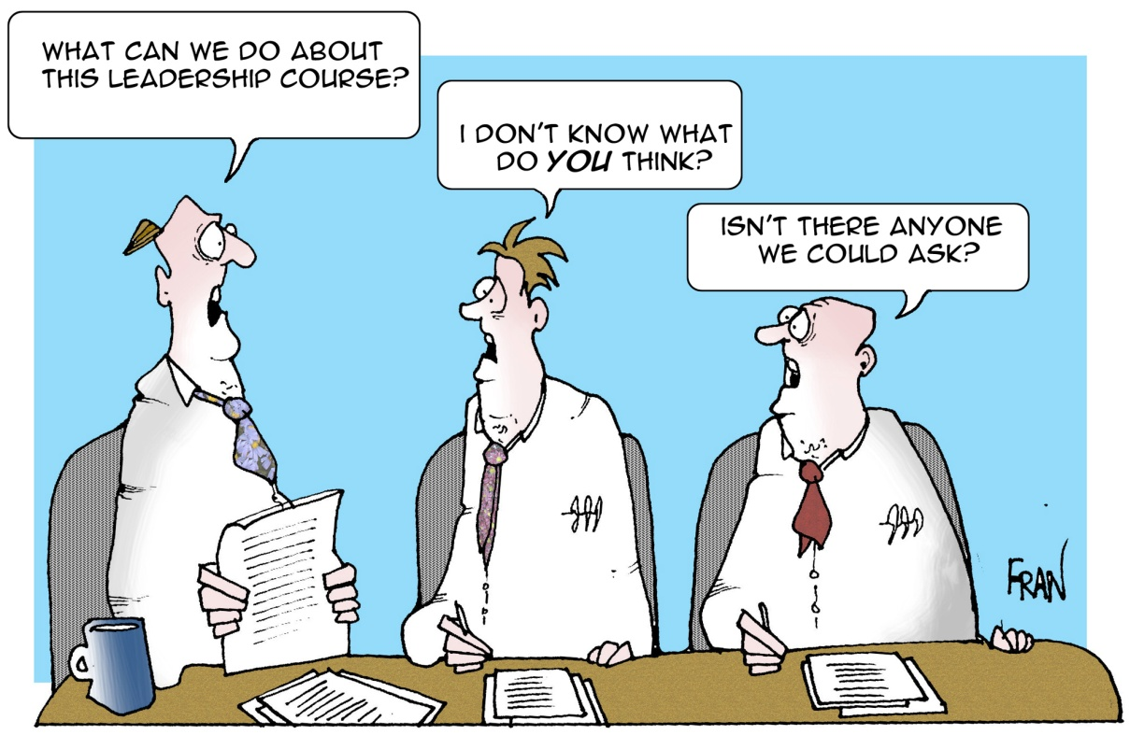
Good Leaders - Characteristics
One approach to finding out what makes good leaders is to identify the qualities, characteristics or traits they should have.

Slide 17

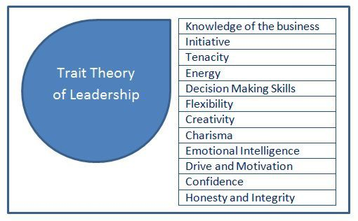

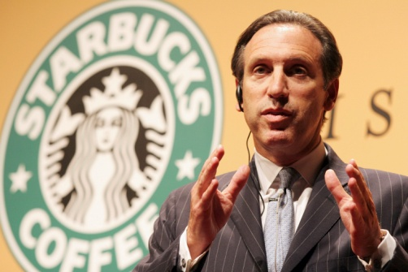
Leadership – Trait Theory

Slide 18
Good Leaders - Characteristics
Effective leaders have a positive self image, genuine ability and realistic aspirations.
Leaders appreciate their own strengths and weaknesses.
Leaders need to be able to get to the core of a problem and have the vision and commitment to suggest radical actions.

Slide 19
Good Leaders - Characteristics
Studies of leaders in business suggest they are experts in particular areas and well read in everything else.
They tend to be out of the ordinary, intelligent and articulate.
Leaders are often creative / innovative.

Slide 20
Good Leaders - Characteristics
Leaders tend to seek new ideas to a problem, ensure important things are done and try to improve standards.
Leaders often have the ability to sense change and can respond to it.

Slide 21

Barry Posner
Professor of Leadership at Leavey School of Business, Santa Clara University.
Conducted a long-term study (30+ years) into what kind of leaders people want to follow.
He came up with just 4 characteristics…

Slide 22
Barry Posner’s TED Talk
Watch the short video and try to identify the characteristics Posner has identified as important.
VIDEO

Slide 23
Posner’s Leadership Traits
Honest – They tell the truth.
Competent – Smart, Capable, Experienced, have good judgement. …Good at their job!
Inspirational – Energetic, Enthusiastic, Optimistic and Passionate.
Forward Looking – Have vision, a purpose, a sense of direction.
Taken Together… Credibility (believability).

Slide 24
Leadership Styles

Slide 25

Starter
What makes a good leader?
List the characteristics of a good leader

Slide 26
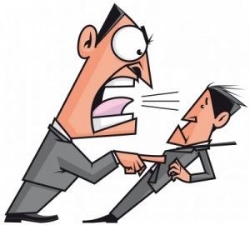
Leadership Styles
Leaders can adopt different leadership “STYLES”.
These different leadership styles have different effects on workers and if a manager adopts a SUITABLE leadership style it can really motivate staff to work hard!

Slide 27
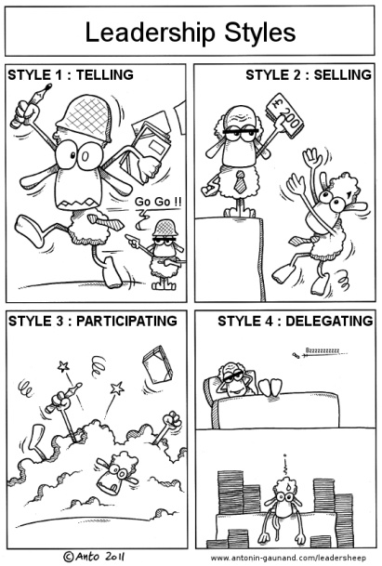
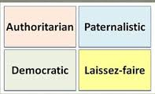
Styles of Leadership

Slide 28

Styles of Leadership

Slide 29
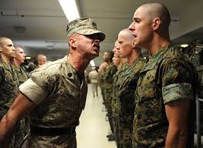
Leadership Styles - Autocratic
Leader makes decisions without anyone else
Staff are highly dependent on the leader
Can de-motivate and alienate staff.
Valuable in some situations, where decisions need to be made quickly.
Military – Police, Army, etc.

Slide 30
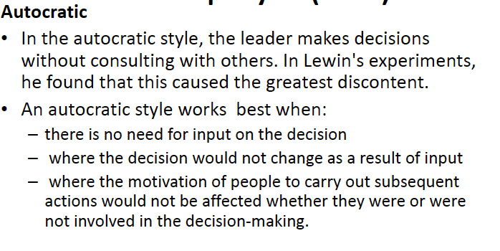
Additional Notes

Slide 31

Leadership Styles - Democratic
Also known as Participative leadership.
Encourages staff to be part of decisions.
May help staff motivation and involvement.
Workers feel ownership of the firm and its ideas.
Can delay decision making.

Slide 32
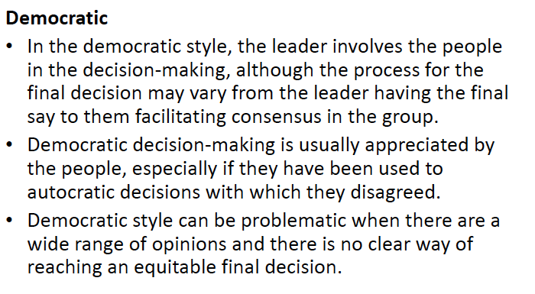
Additional Notes

Slide 33
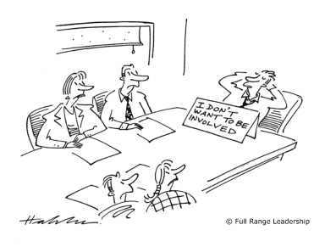
Leadership Styles – Laissez-Faire
‘Let it be’ – the leadership responsibilities are shared by all.
Useful in businesses where creative ideas are important
Can be highly motivational, as staff have a lot of control.
Can be a slow process.
Relies on good team work and good interpersonal skills.
Art – Doctors- Design

Slide 34
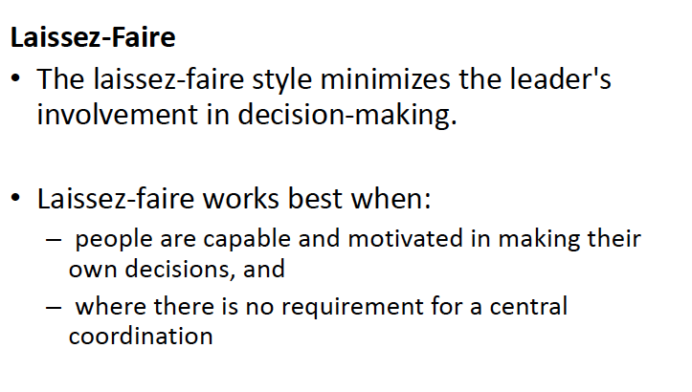
Additional Notes

Slide 35
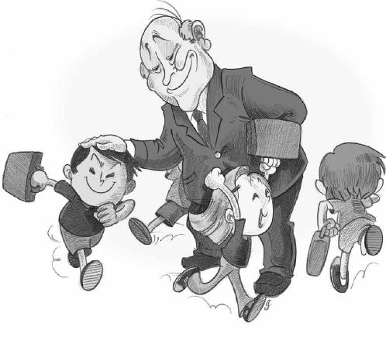
Leadership Styles - Paternalistic
Leader acts as a ‘parent’
Leader makes decision but consults with staff.
Similar to autocratic, leaders make the decisions and expect employee to obey them.
Believes in the need to support staff.

Slide 36
Leadership Questionnaire
So Which type of leader do you think you are
Leadership Questionnaire Results!

Slide 37
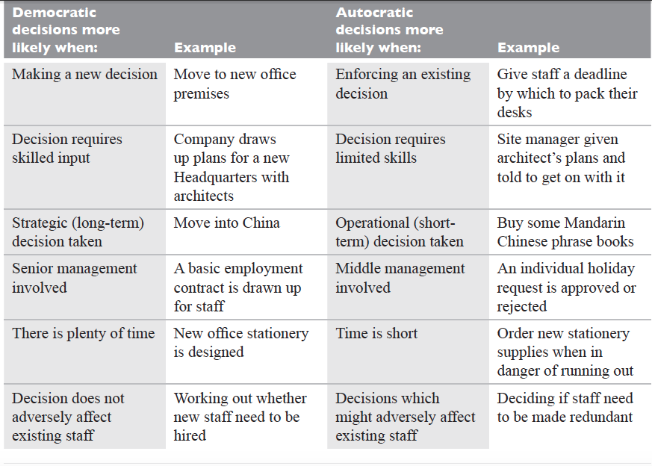

Slide 39
Factors Affecting Leadership Style
Risk
Type of business
Type of labour force
Organisational culture
Organisation Leadership
Nature of the task
Group size
Leader’s personality
Group personality
Time

Slide 40
Why do Leaders adopt Different Styles?
“It is easier to change someone’s role or power, or to modify the job he has to do, than to change his leadership style.”F. Fiedler (Contingency theory,1967)
Leadership Match
Task orientated leaders
Relationship oriented leaders
Theory X & Y
How do managers view there employees?
Theory X manager – Autocratic/paternalistic
Theory Y manager – Laissez-faire / Democratic

Slide 41
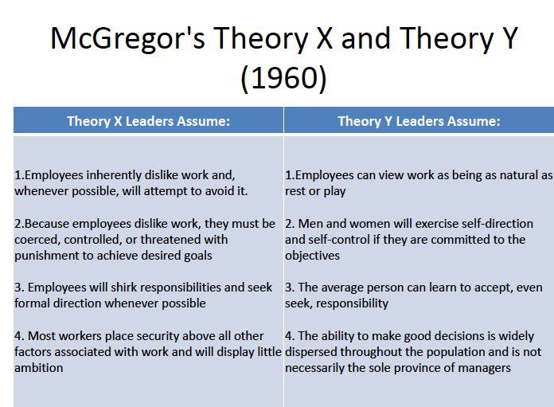

Slide 42
Why do Leaders adopt Different Styles?
A leader should take the maturity of her employees into account when choosing a leadership strategy.
Task Behaviour – how much does the leader need to organise her employees tasks
Relationship behaviour – how much support is needed and how much personal contact is necessary
Together, these factors will determine which of the following leadership styles will be used:
Delegating
Participating
Selling
Telling

Slide 43
Conclusions…
We’ve seen different styles of leadership:
Would you say there is a “right” and a
“wrong” way to lead people?
Explain your ideas…

Slide 44
REALITY!
Some only one style
MOST
A mixture depending on the situation -
Emergency order
Future planning
Design specialist

